Slide 1
Chemistry 1,2 – Aug 14, 2019 Chemistry 8 – Aug 15, 2019
Do Now
Find your Assigned Seat
Pick up a Verification sheet and a file card (at center of desks)
Then complete a contact card with the following information: (As much as possible…)
Your name:
Your Preferred email address:
Mom’s Name: Mom’s best contact phone number and time:
Mom’s email:
Dad’s Name: Dad’s best contact phone number and time:
Dad’s email:
Albert’s Life Lesson for August (#1) Find this on my faculty website which also gives access to the syllabus.
Notes:
Today: About the course and Chemistry, in general

Slide 2
Objectives and Agenda
Course Overview Objectives
Know how the units of the course for the year are organized
Know how the course will be evaluated
Know how the class time and activities will generally proceed
Know the behavioral expectations for the course and the corresponding consequences, including how absences are handled.
Agenda
Review syllabus
Learning models
Chemistry overview
Crosscutting Concepts Jigsaw Activity
Assignment:
Syllabus Verification, signed by you and a parent/guardian due by Aug 19/20

Slide 3
The Learning Curve
How we Learn | Don’t know | Know
Think | 2) Can identify what you don’t know Scanning provides this information Uncomfortable or exciting Ready to learn Goal setting | 3) Know it when you think about it Educated Practice helps 2 → 3 Requires work/energy Use it or lose it Pride of accomplishment
Don’t think | 1) You don’t know what you don’t know Ignorance is bliss | 4) Know it, even if you don’t think about it Mastery Like riding a bike, or reading Hard to unlearn or forget Changes who you are (even physically)

Slide 4
The Reach
The great unknown
The Reach
What you know or can do alone
What all humankind knows or can do
You with help

Slide 5
Chemistry
Chemistry is the scientific study of matter, its properties, and its behavior.
https://www.youtube.com/watch?v=izeuGr0lbN0
Intro to chemistry video

Slide 6
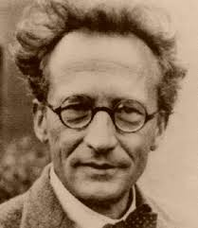
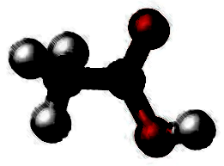
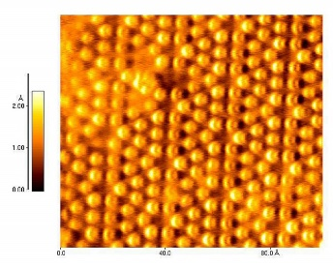
6 types of understanding Chemistry
Communication methods
Symbols / Models
Names
Measurements / Math
Conceptual levels
Macroscopic
Atomic / Nanoscopic
Theoretical
Keep in mind what type of understanding is involved.
Vinegar
Acetic acid
CH₃COOH

Slide 7
7 Cross Cutting Concepts
Ideas that are present in science that also occur in other contexts as well.
There are 7 defined by the NGSS:
1. Patterns
2. Cause and Effect
3. Scale Proportion and Quantity
4. Systems and System Models
5. Energy and Matter: Flow, Cycles and Conservation
6. Structure and Function
7. Stability and Change

Slide 8
Jigsaw CCC Activity
Count off from 1 to 7 to determine what CCC you will become an expert on.
With your fellow experts, watch the video indicated for your CCC and answer the corresponding 3 questions for your topic.
1. Patterns #1-3
2. Cause and Effect #4-6
3. Scale Proportion and Quantity #7-9
4. Systems and System Models #10-12
5. Energy and Matter: Flow, Cycles and Conservation #13-15
6. Structure and Function #16-18
7. Stability and Change #19-21

Slide 9
Apply your expertise
Rewatch the introduction to chemistry video looking for evidence of your CCC. Take notes.
After the video, discuss with your team for 5 min to come to agreement about what to report.
Each team of experts will then present their findings including
A) A summary of what their topic is
B) Their answers to their three questions
C) The evidence they saw of their CCC in the Intro to chemistry video.

Slide 10
Today’s Assignment
What’s Due? (Pending assignments to complete.)
Syllabus Verification, signed by you and a parent/guardian due by Aug 19/20.
Download and print the syllabus.
Complete your group’s questions. Be ready to share with class next time.
What’s Next? (How to prepare for the next day)
Completion of the CCC Jigsaw activity
Science and Engineering Practices

